Slide 1


DEPARTMENT OF COMPUTER SCIENCE & ENGINEERING
SCHOOL OF COMPUTING
10214CS602 MINOR PROJECT –II INDUSTRY PROJECTS
WINTER SEMESTER(2023-2024)
REVIEW-II
“CARTOONIFY AN IMAGE WITH OPENCV”
SUPERVISED BY
PRESENTED BY
Dr.K.NAVAZ ,ME,Ph D.,
1.K.ROHITH CHOWDARY (19134)(21UECT0061)
2.K.VINAY KRISHNA (20388(21UECT0070)
3.D.VENKATESH (20424)(21UECT0067)

Slide 2
OVERVIEW
ABSTRACT
OBJECTIVE
INTRODUCTION
LITERATURE REVIEW (SOFT COPY OF PAPERS TO BE LINKED AS HYPERLINK)
DESIGN AND METHODOLOGIES
IMPLEMENTATION
TESTING
INPUT AND OUTPUT
INCLUDE DEMO VIDEO-1 (Till REVEW-1)
INCLUDE DEMO VIDEO-2(Complete Implementation of Project)
CONCLUSION
WEB REFERENCES LINK (TILL REVIEW DATE ALL LINKS TO BE INCLUDED DAY WISE)
PLAGIARISM REPORT OF PPT
REFERENCES

Slide 3
ABSTRACT
It's a popular image processing technique used for various purposes like entertainment, art, and even facial recognition systems.
To demonstrate how to use OpenCV, a popular computer vision library, to cartoonify an image.
This technique can be used for enhancing images for creative purposes, creating caricatures, or preprocessing images for further analysis.
Utilize OpenCV library in Python, which provides functions for image manipulation and processing.
Convert the input image to grayscale to simplify the process.
The result will be a cartoonified version of the input image, with smoothed colors and emphasized edges, resembling a hand-drawn cartoon.
Cartoonifying images using OpenCV provides a fun and creative way to transform ordinary photos into cartoon-like representations.

Slide 4
OBJECTIVES
Aim of the Project:
The main Aim is to convert an image to the cartoon image by developing a software and processed by machine learning algorithms for the conversion of images.The algorithm is designed to provide artistically and comically appealing results on as wide a range of pictures as possible, although it is conceded that all inputs will yield equally satisfying results.Creating a fun and interesting visual effect that can be used for artistic or entertainment purposes. Demonstrating the power and versatility of OpenCV as a tool for image processing and computer vision. Learning and practicing fundamental image processing techniques such as edge detection, color quantization, and image smoothing. Exploring the intersection of art and technology, and how image processing can be used to create new forms of visual expression.
Scope of the Project:
The scope of the project is to produce cartoon images from real one with atmost accuracy. The implementation of machine learning tool is a great approach of getting a clear and good edge masked cartoon images or videos. And also it can be suggested to various animations to get their desired results in an easiest way. The project can also be further enhanced by integrating it with other computer vision techniques, such as object detection or facial recognition, to create more advanced visual effects.

Slide 5
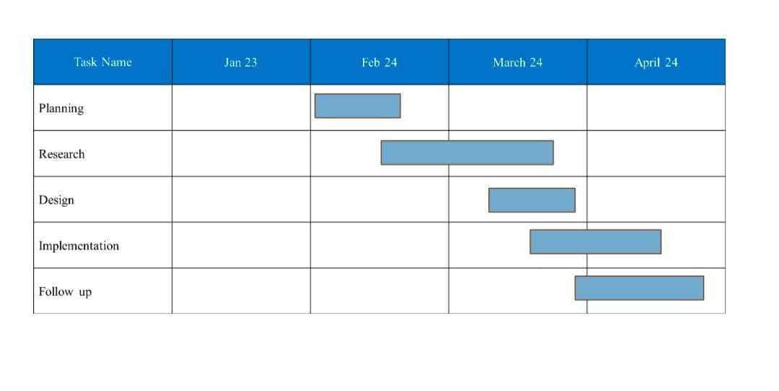
TIMELINE OF THE PROJECT

Slide 6
INTRODUCTION
It involves transforming a regular photograph or image into a cartoon-like representation, which simplifies the colors and emphasizes the edges, giving it a hand-drawn appearance.
This technique is widely used in various fields, such as video games, animation, and movies.
GAN is a popular computer vision library that provides tools and functions for image processing and analysis.
It is widely used in various applications, including object detection, facial recognition, and image segmentation.
In this project, we focus on using GAN to create a cartoon-like representation of an input image.
The proposed approach consists of several steps, including edge detection, color quantization, and image filtering.
The edgedetection step involves identifying the edges in the image using Canny edge detection.
Next, the color quantization step reduces the number of colors in the image using k-means clustering.
Finally, a bilateral filter is applied to smooth the image while preserving the edges.
The resulting output image resembles a cartoon by simplifying the colors and emphasizing the edges, giving it a hand-drawn appearance.
The performance of the proposed method is evaluated on several input images, and the results show that the proposed method can successfully generate cartoon-like images with high accuracy and efficiency.

Slide 7
LITERATURE REVIEW
Sl.No | Author’s Name | Paper name and publication details | Year of publication | Main content of the paper
1 | Gayen, S. Jha, S. Singh, M. Kumar, R | International journal of Engineering and Advanced Technology | 2021 | Introduction to plithogenic hyper soft subgroup.
2 | S. Smarandache, F. Jha, S. Singh, M. K. Broumi | Neutrosophic Sets and Systems | 2021 | On a generalized notion of anti fuzzy subgroup and some characterizations
3 | P. Isola, J.-Y. Zhu, T. Zhou, and A. A. Efros | arXiv preprint arXiv:1611.07004, | 2022 | Image to image translation with conditional adversarial networks,

Slide 8
Sl. NO | Author’s Name | Paper name and publication details | Year of publication | Main content of the paper
4 | S. Y. Muhammad, M.Makhtar, A. Rozaimee, A. Abdul, and A. A.Jamal, | International Journal of Software Engineering and Its Applications, pp. 45-52 | 2022 | Classification model for air quality using machine learning techniques
5 | P. Isola, J.-Y. Zhu, T. Zhou, and A. A. Efros | arXiv preprint arXiv:1611.07004, | 2021 | Image to image translation with conditional adversarial networks,

Slide 9
DESIGN AND METHODOLOGIES
MODULE 1: Generative Adversarial Networks (GANs)
MODULE 2:Anomaly Detection Model

Slide 10
MODULE 1: Generative Adversarial Networks (GANs)
Step:1 Collection of data
Generative Adversarial Networks (GANs) are algorithmic architectures that use two neural networks, pitting one against the other (thus the “adversarial”) in order to generate new, synthetic instances of data that can pass for real data.
They are used widely in image generation, video generation and voice generation.
A generative adversarial network (GAN) is a deep neural network framework which is able to learn from a set of training data and generate new data with the same characteristics as the training data.
CartoonGAN is a GAN framework for cartoon stylization that takes unpaired photos and cartoon images for training.
It proposes two novel losses suitable for cartoonization a semantic content loss, which is formulated as a sparse regularization in the high-level feature maps of the VGG network a style loss that encourages the generation of diverse styles.

Slide 11
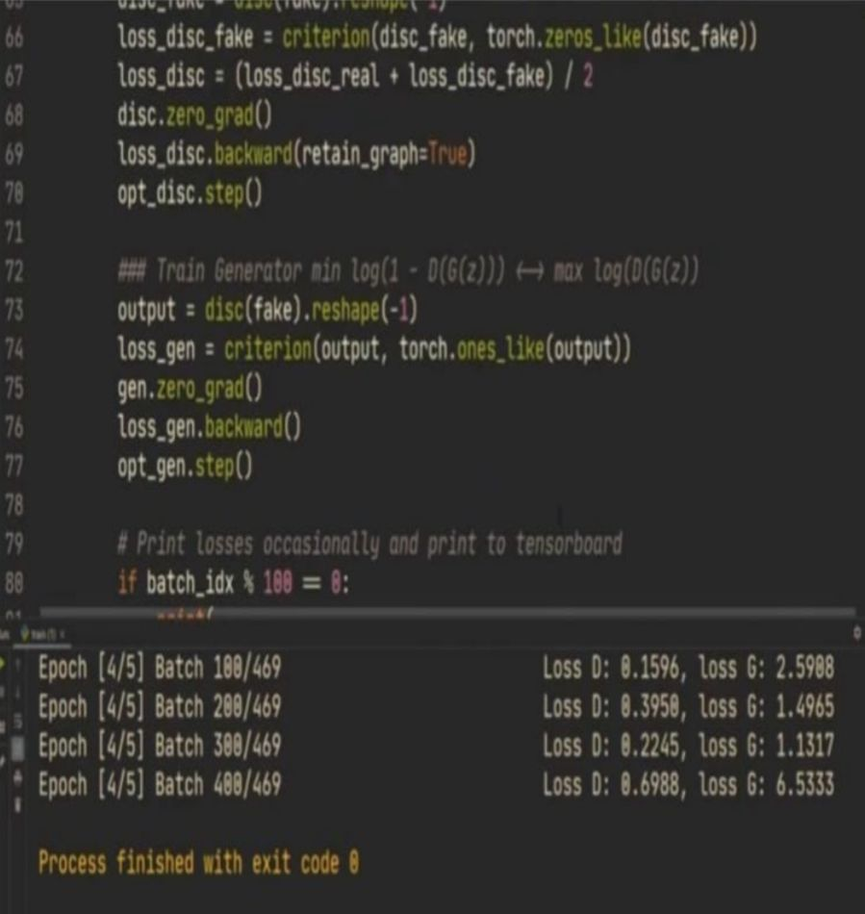
Step 2: Processing the data
.

Slide 12
Module 2- Anomaly Detection Model
After the traffic forecast model, the anomaly detection model serves as the second line of defence. The original Ethernet/IP control packet could be dropped by malicious attackers, who might then substitute a fake packet with the incorrect control instructions. The traffic prediction model cannot identify the forging and bogus data injection attacks since they have little effect on traffic flow. Establishing an anomaly detection model for the forging attack and bogus data injection assault is therefore important. The Ethernet/IP control packets were initially filtered out by the anomaly detection model based on the field of service.The control packets’ service name was assigned to a single attribute with a code like 0x10. Specific control instructions should be derived from the control packets after getting them.The four aspects of the control instructions were relative time, action, direction, and speed. The packet time stamp relative to the control period, which served as a control cycle for the application, is referred to as the relative time.

Slide 13
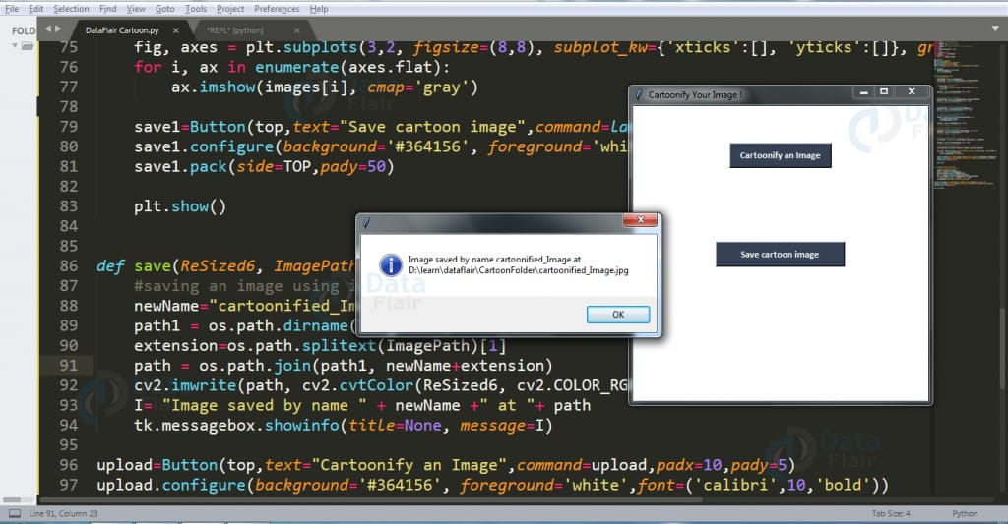
Step 3: Using algorithm’s name algorithm

Slide 14
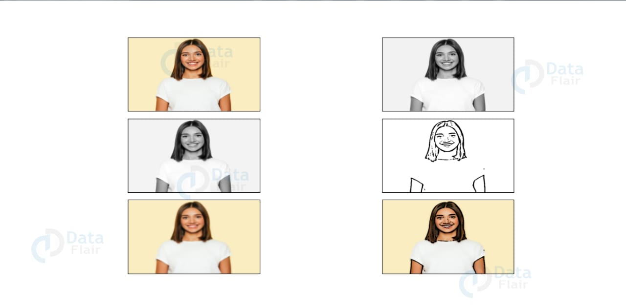
Step 4: The output

Slide 15
IMPLEMENTATION
Architecture Diagram
Data –Flow Diagram
Use Case Diagram
Class Diagram
Activity Diagram
Sequence Diagram
Collaboration Diagram(If applicable)
E-R Diagram
It’s a sample only and may vary according to the project

Slide 16
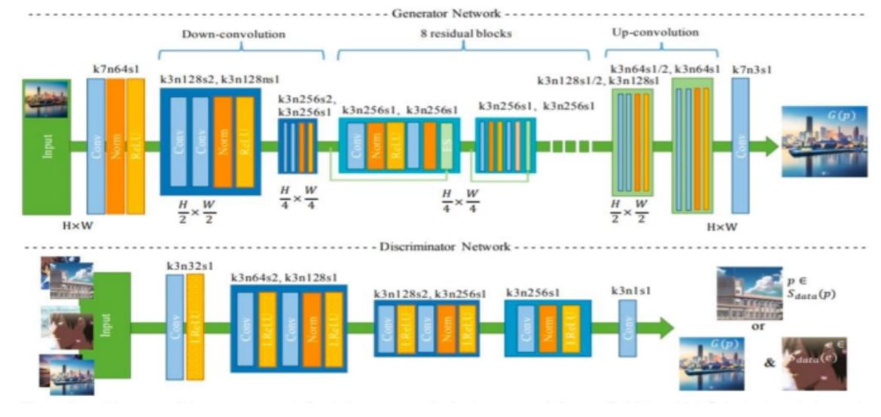
Architecture Diagram

Slide 17
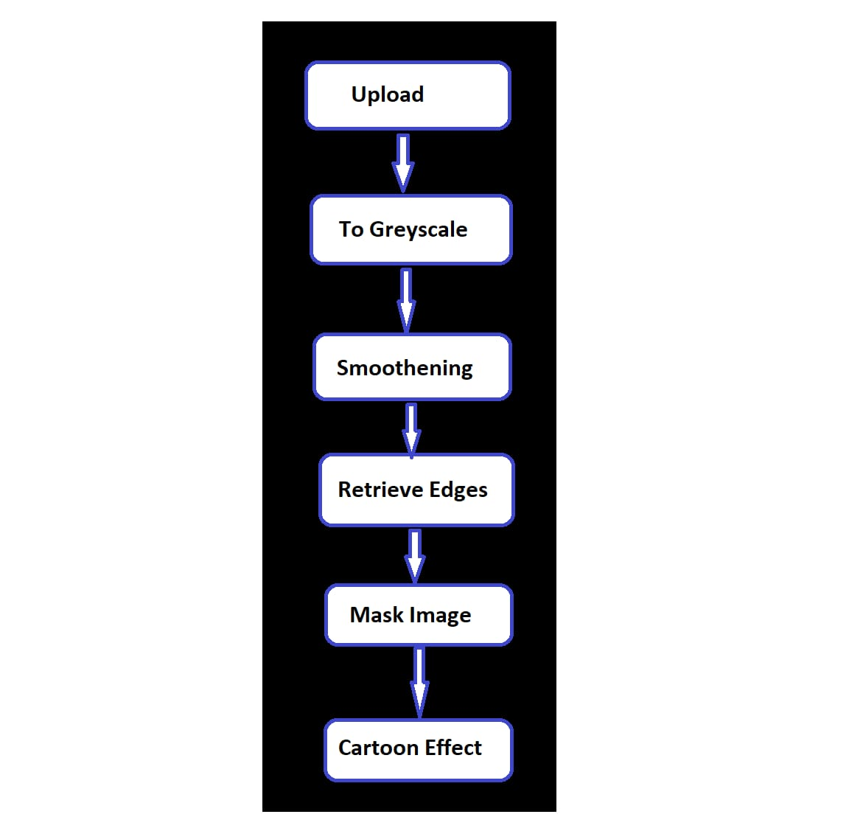
Data –Flow Diagram

Slide 18
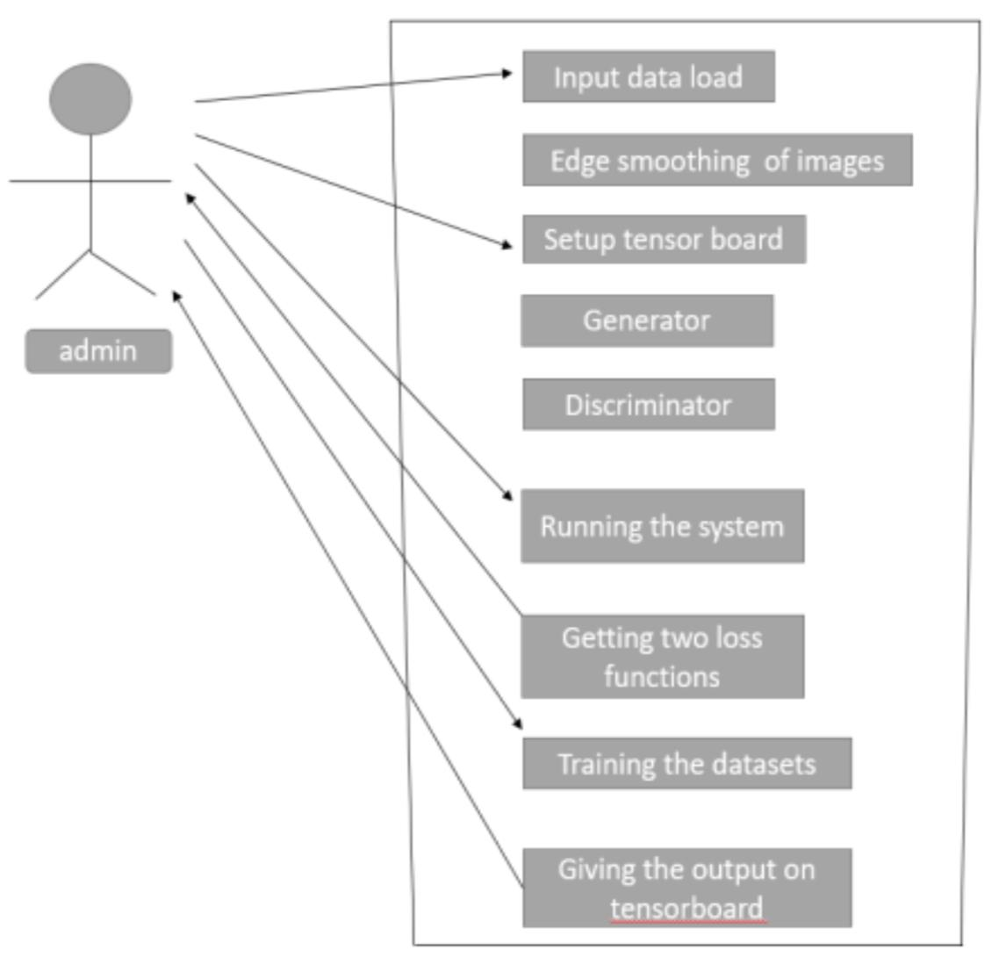
Use Case Diagram

Slide 19
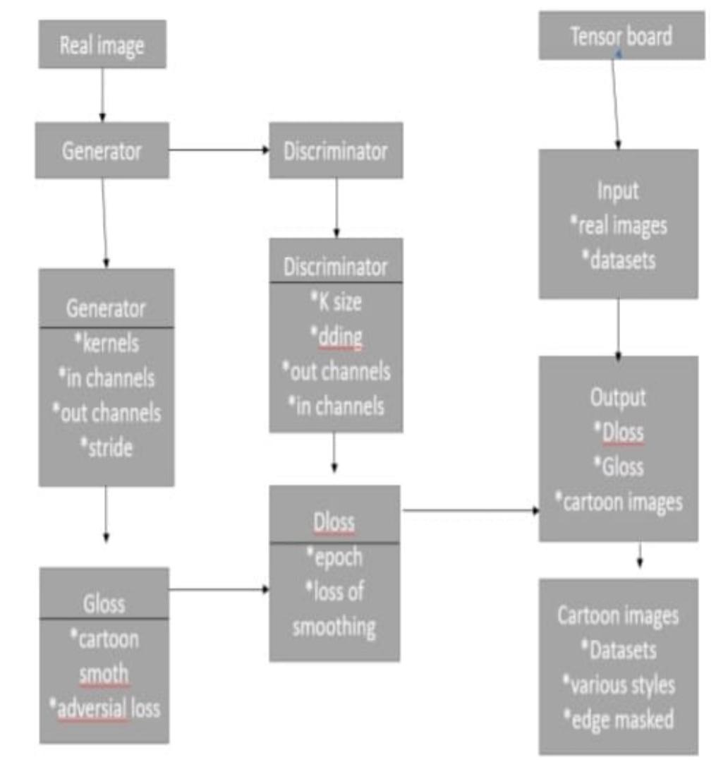
Class Diagram

Slide 20
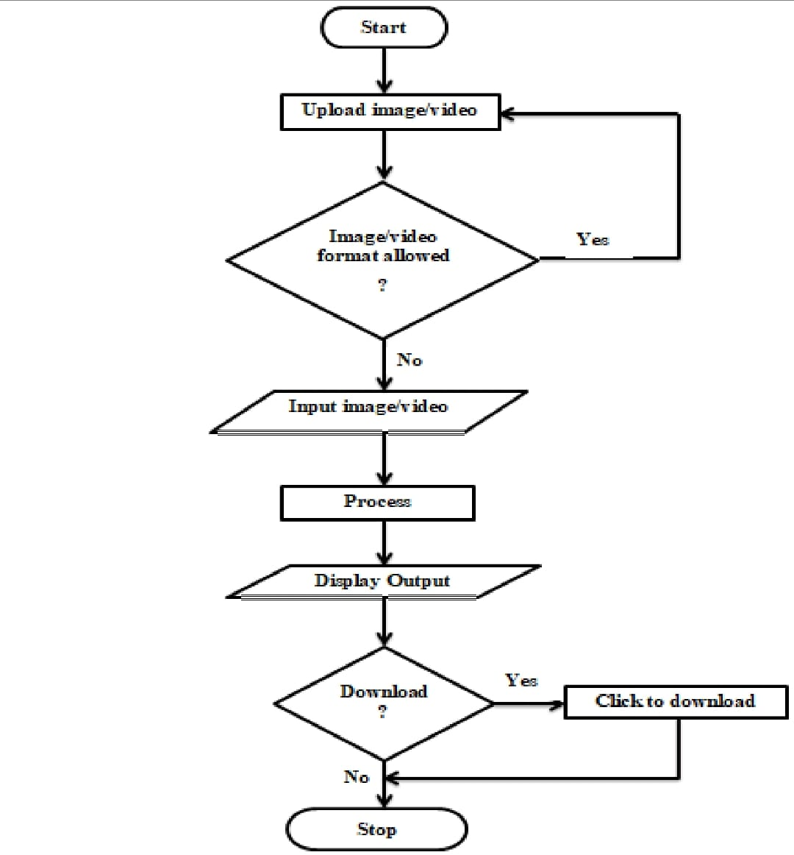
Activity Diagram

Slide 21
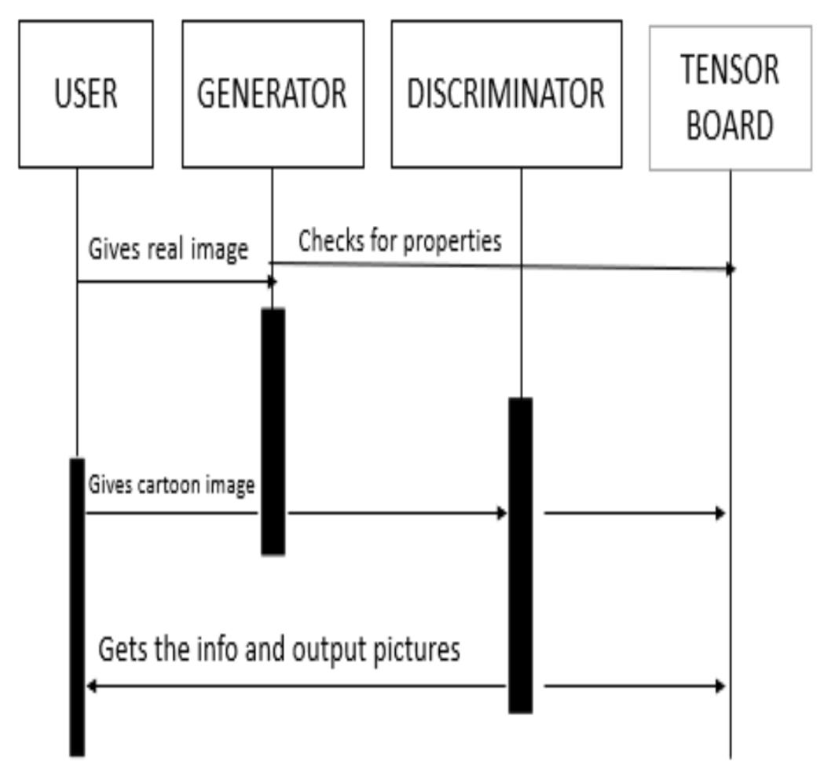
Sequence Diagram

Slide 22
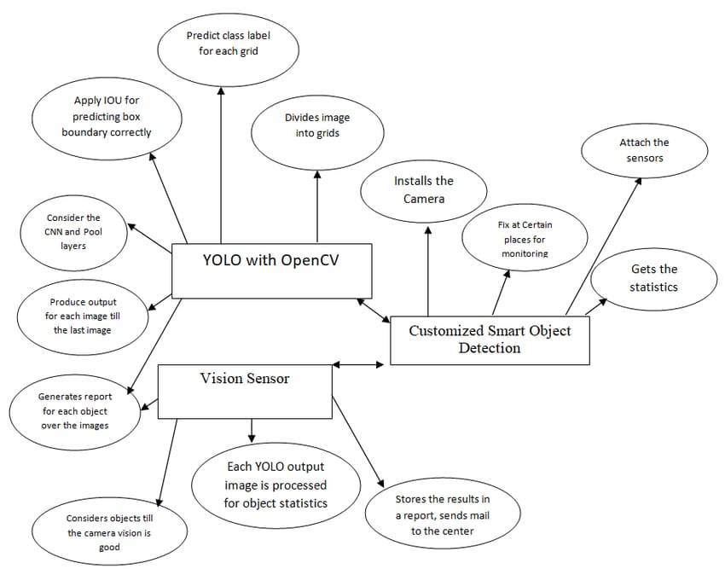
E-R Diagram

Slide 23
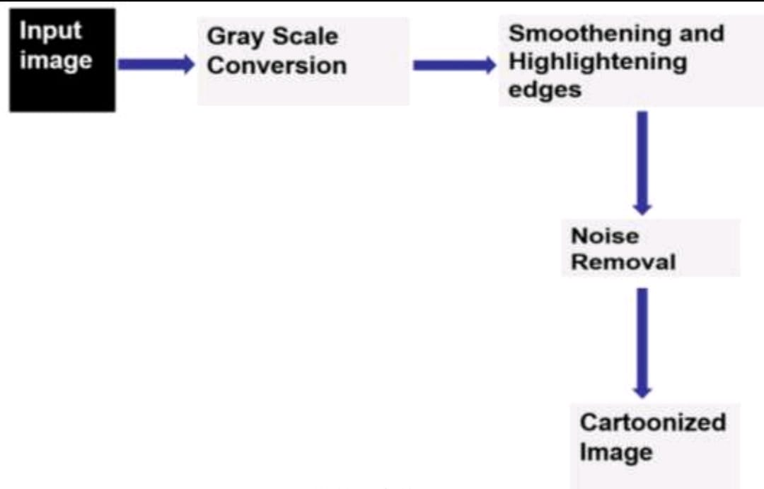
Collaboration Diagram(If applicable)

Slide 24
TESTING
UNIT TESTING
INTEGRATION TESTING
FUNCTIONAL TESTING
WHITE BOX TESTING
BLACK BOX TESTING

Slide 25
UNIT TESTING
A unit test is a way of testing a unit - the smallest piece of code that can be logically isolated in a system. In most programming languages, that is a function, a subroutine,a method or property. The isolated part of the definition is important. In his book ”Working Effectively with Legacy Code”, author Michael Feathers states that such tests are not unit tests when they rely on external systems: “If it talks to the database, it talks across the network, it touches the file system, it requires system configuration, or it can’t be run at the same time as any other test.”As our code is efficient for unit testing as we can test the units of the code to get the results accurately.
INTEGRATION TESTING
Integration testing is a critical phase in the development process, particularly for projects involving OpenCV for image processing. It involves testing the combination of different software modules or components within the application to ensure they work together as intended. For a project that manipulates or processes images using OpenCV, integration testing would focus on verifying the interaction between the OpenCV library, the application's modules, and other dependent components such as file handling, user interface, and other image-related functions. This testing ensures that the application accurately processes, transforms, and displays images as expected, and can handle various input formats and edge cases. By running integration tests, developers can catch and resolve issues early on, leading to a more stable and reliable application.

Slide 26
SYSTEM TESTING
System testing for a project that involves image coordination using OpenCV is crucial to ensure the program's reliability and performance. This testing phase focuses on evaluating the system's overall functionality, including processing images, applying image transformations, and handling different formats and resolutions. During system testing, various test cases are designed to validate the system’s capability to load images, perform operations such as resizing, cropping, filtering, and coordinate manipulations accurately and efficiently. Additionally, the program's ability to handle edge cases, such as images with unusual dimensions or color schemes, is assessed to ensure robustness. Integration testing between OpenCV functions and other components, such as user interface or data storage, is also essential. Lastly, performance testing verifies the system’s speed and resource usage, while regression testing ensures that updates do not negatively impact existing functionalities.
FUNCTIONALTESTING
Functional testing in the context of an image coordination project using OpenCV involves verifying that the software correctly handles and processes images as intended. This includes checking whether image coordination tasks, such as aligning, resizing, or transforming images, are performed accurately and efficiently. Tests can include verifying the software's ability to detect and process images of various formats and sizes, ensuring that it applies transformations such as rotation or scaling accurately, and confirming that any output matches expected results. By running functional tests, developers can validate that the OpenCV project correctly coordinates images, meets user requirements, and performs reliably under different conditions.

Slide 27
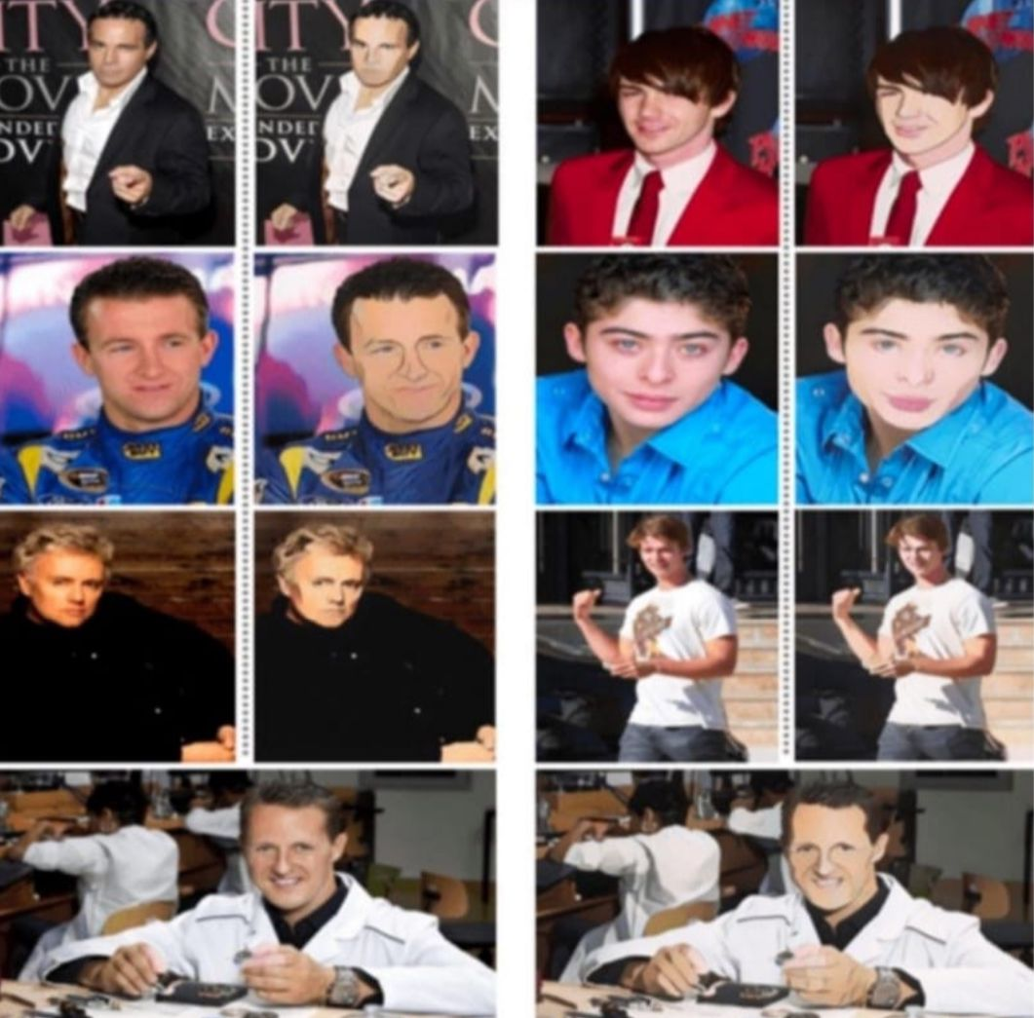
INPUT AND OUTPUT

Slide 28
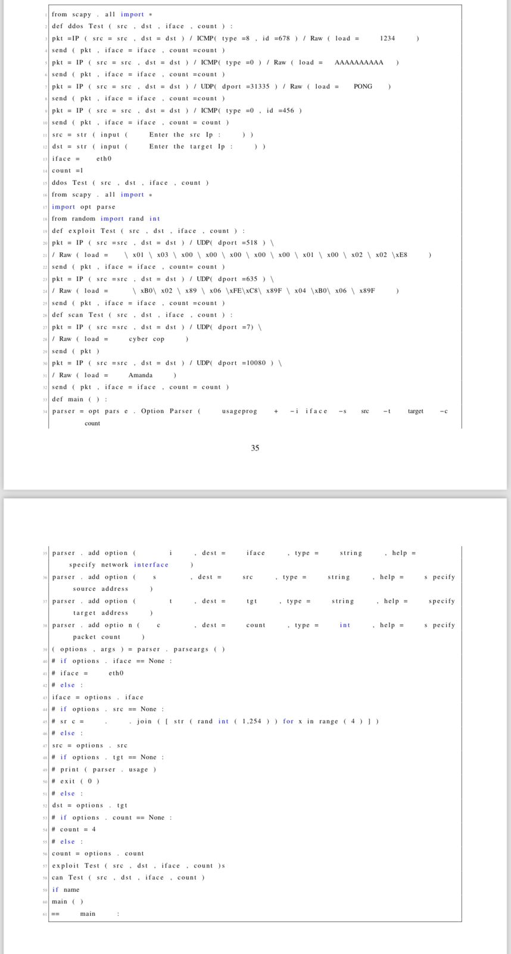
SOURCE CODE

Slide 29
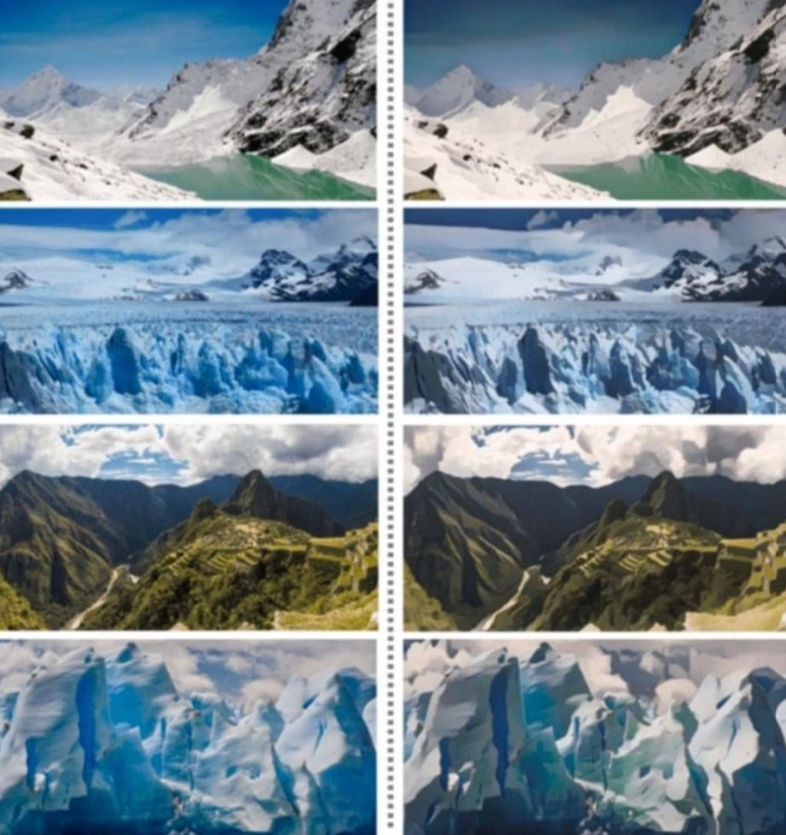
OUTPUT

Slide 30
CONCLUSION
Many Companies analyzed that Advertising their products using Cartoon images will helps them to attract people. Nowadays many schools are introducing Cartoonified books to the children. As in the World which is rapidly Increasing Technology Cartoonizing plays a great role in various aspects. Nowadays, Cartoons are used primarily for conveying political commentary and editorial opinion in Newspapers and also used in social comedy and Magazines. Thus our project helps various sectors which includes cartoonization. It is important to preprocess the image before applying any filter or effect. This includes resizing the image to a smaller size, converting it to grayscale, and smoothing it to remove any noise or unwanted details. By carefully considering each step and its impact on the image, it is possible to create a wide range of unique and interesting cartoon-style images using OpenCV.

Slide 31
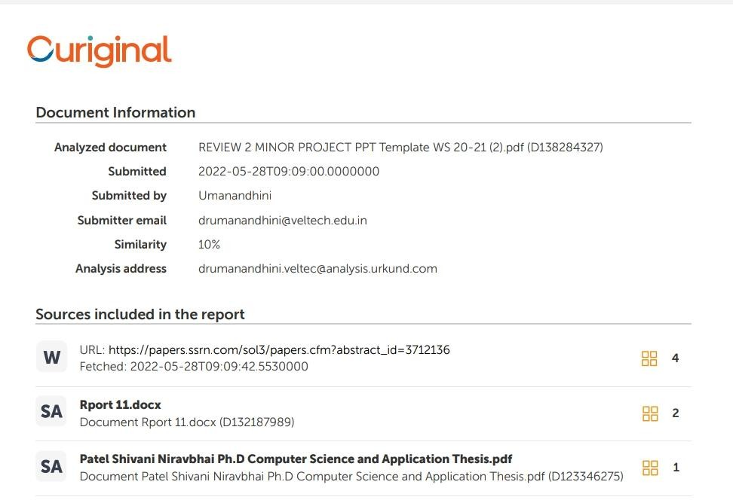
Plagiarism Report of PPT
Plagiarism should be less than 10%.
Eg,

Slide 32
Web references/video links
A minimum of four sample URLs have to be attached here.

Slide 33
REFERENCES
[1]An insider’s ”GUIDE TO CARTOONIZATION USING MACHINE LEARNING - Daksh Trehan - 2021 - July - 10.
[2] Gayen, S. Jha, S. Singh, M. Kumar, R. On a generalized notion of anti - fuzzy subgroup and some characterizations. International journal of Engineering and Advanced Technology 2021.
[3] Gayen, S. Smarandache, F. Jha, S. Singh, M. K. Broumi, S. Kumar, R. Introduction to plithogenic hyper soft subgroup. Neutrosophic Sets and Systems 2021.
[4] P. Isola, J.-Y. Zhu, T. Zhou, and A. A. Efros, “Image to image translation with conditional adversarial networks,” arXiv preprint arXiv:1611.07004, 2018.
[5] S. Y. Muhammad, M. Makhtar, A. Rozaimee, A. Abdul, and A. A.Jamal, “Classification model for air quality using machine learning techniques,” International Journal of Software Engineering and Its Applications, pp. 45-52, 2020.
[6] V. Ravi, Ch.Rajendra Prasad, S. Sanjay Kumar, P. Ramchandar Rao Image enhancement on OpenCV based on the tools : python 2.7 - Dept of ECE. SR College, Telangana, India - Feb 2022.
[7] Wang, Xinrui, and Yu, Jinze. Learning to cartoonize using White-box cartoon Representations. IEEE/CVF conference on computer vision and pattern recognition (CVPR).June 2022.
[8] Y. Chen, Y.-K. Lai, Y.-J. Liu, ”Cartoon GAN: Generative Adversarial Network for photo cartoonization”, International Conference on Image Processing, 2019.
[9] Yi-Hsuan Tsai, Kihyuk Sohn, Samuel Schulter, and Man- mohan Chandraker. Domain adaptation for structured output via discriminative representations. arXiv preprint arXiv:1901.05427, 2019.
[10] Ziqiang Zheng, Chao Wang, Zhibin Yu, Nan Wang, Haiy- ong Zheng, and Bing Zheng. Unpaired photo-to-caricature translation on faces in the wild. Neurocomputing, 355:71– 81, 2020.

Slide 34
THANK YOU

